Slide 1


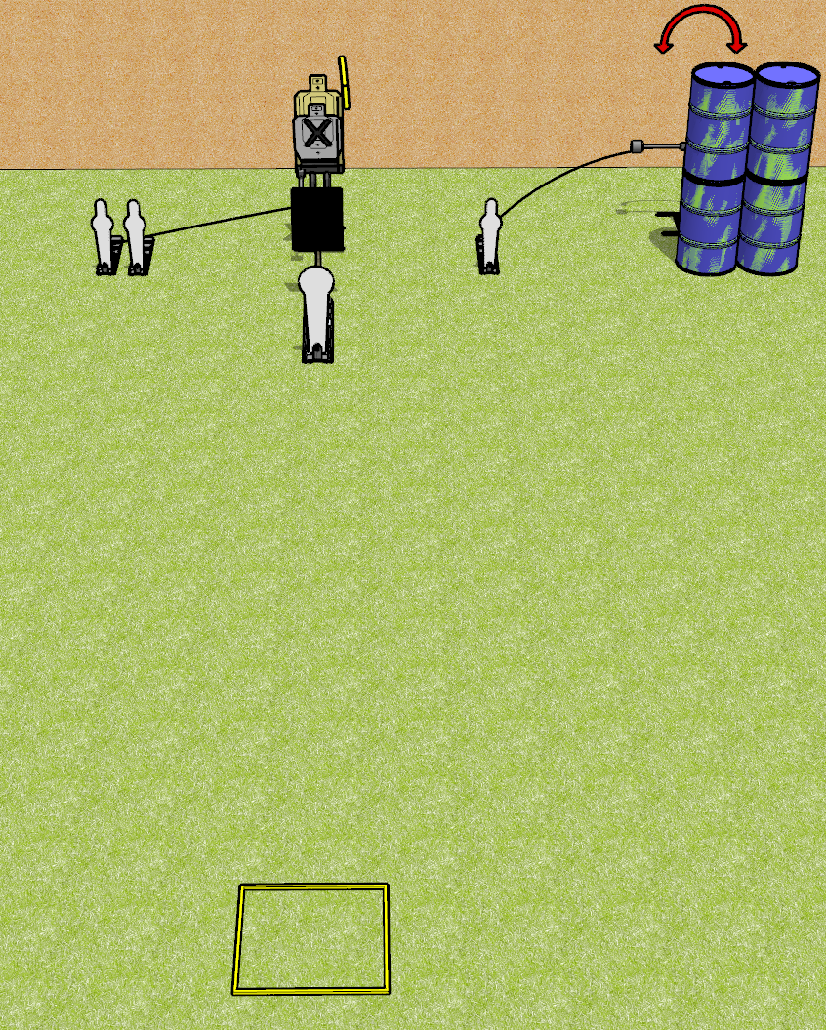
 | Dothan Gun Club – USPSA Match Don’t Overthink It Course Designer : Drew Coleman
Round Count 8 rounds 2 USPSA 1 colt popper, 3 mini poppers
Equipment List Max trap + activator, swinger + activator Shooting box 18x24 plate + stand to protect the max trap Make sure the shooting box is centered on the max trap

Slide 2
Don’t Overthink It
Written Stage Briefing
Don’t Overthink It is an 8 round, 40 point, Comstock speed shoot. There are 2 USPSA targets, 1 colt popper, and 3 mini poppers. The best 2 hits on paper will score, and steel must fall to score. The start signal is audible.
The max trap is activated by either of the leftmost mini poppers and remains visible at rest. The swinger is activated by the right mini popper and remains visible at rest. Please check the activators prior to walkthrough and set them the same way every time.
Handgun start position is in shooting box, wrists below belt. Handgun is loaded and holstered.
PCC start position is in shooting box, stock on belt. Carbine is loaded, held with both hands, safety on.
On start signal engage targets as they become available from within the shooting area.

